Slide 1

THYNK UNLIMITED
MachIne LearnIng Models for Real Estate PrIce PredIctIon:
A ComparatIve AnalysIs
WE LEARN FOR THE FUTURE
Jyothi Swaroop Muralasetti
PRESENTED BY:

Slide 2
PRESENTATION OUTLINE
Business problem
Data Collection & Pre-processing
Feature Engineering & Selection
Principal Component Analysis (PCA)
Model Selection & Evaluation
Case Study & Insights
Limitations & Future Scope

Slide 3
BUSINESS PROBLEM
Real estate prices fluctuate based on location, size, and quality.
Accurate valuation is key for buyers, sellers, and investors.
Traditional methods lack precision and are time-consuming.
Mispricing risks lead to financial loss and delays in sales.
ML models enhance price prediction, efficiency, and decision-making.

Slide 4
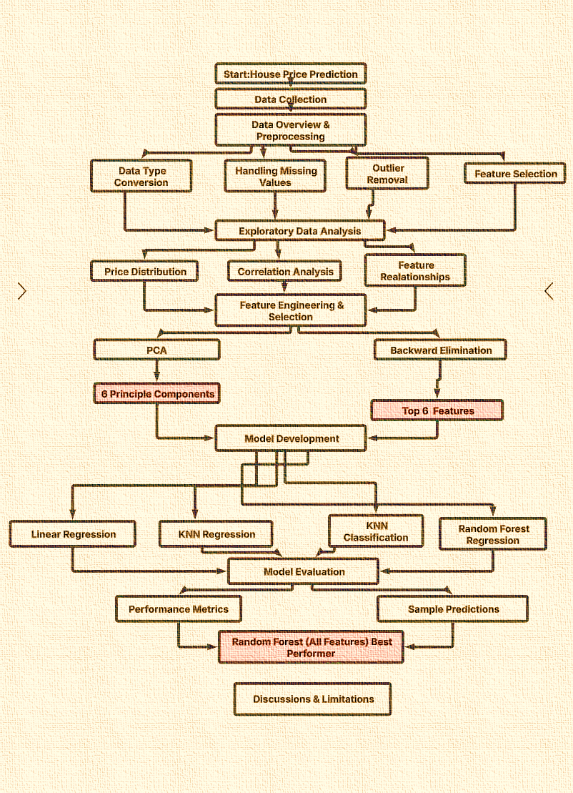
How dId we approach to thIs Problem?
A Flowchart that depIcts
our end-to-end process

Slide 5
DEPLOYMENT AND INTEGRATION
DATA PREPARATION
MODEL DEVELOPMENT
MODEL EVALUATION
Data collection, cleaning, and preprocessing
Ensuring data quality and reliability
Data labeling and annotation
Selection of appropriate machine learning algorithms
Model architecture and hyperparameter tuning
Training process and validation
Cross-validation and testing on validation datasets
Assessing model performance, including accuracy, precision and recall

Slide 6
Data overvIew
Dataset Description:
Statistic | Price ($) | Bedrooms | Bathrooms | Sqft_living | Grade
Count | 21,516 | 21,516 | 21,516 | 21,516 | 21,516
Mean | 534,883 | 3.37 | 2.11 | 2,080 | 7.66
Min | 75,000 | 0 | 0 | 290 | 1
25% | 321,950 | 3 | 1.75 | 1,427 | 7
50% | 450,000 | 3 | 2.25 | 1,910 | 7
75% | 645,000 | 4 | 2.5 | 2,550 | 8
Max | 2,500,000 | 33 | 8 | 13,540 | 13
Our analysis utilizes a housing dataset containing information about properties in King County, Washington
Dataset Size: 21,613 records, 21 attributes
Target Variable: Sale price ($75,000 - $2.5 million)
Categorical Features: Waterfront, view, condition, etc.
NumericalFeatures:Bedrooms,bathrooms, sqft_living, grade, year built, etc.

Slide 7
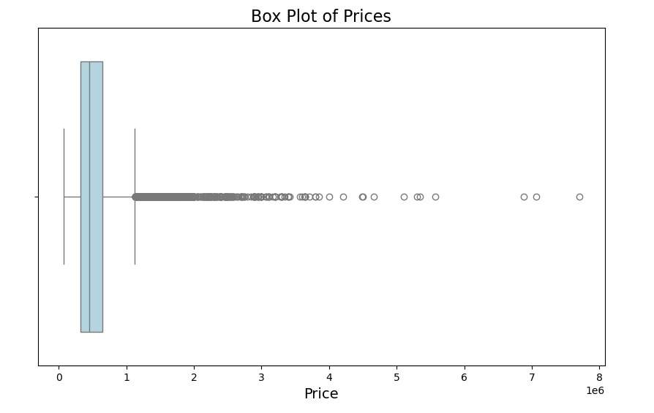
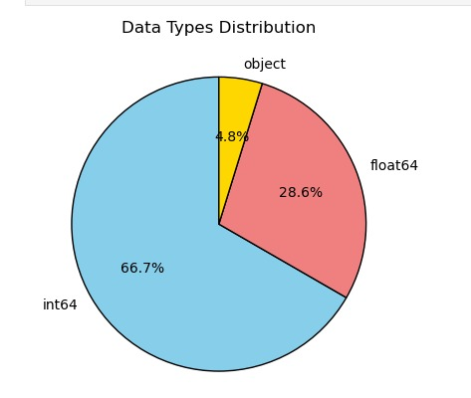
DATA PRE-PROCESSING
Type Conversions: Date to datetime, Zipcode to string.
Outlier Removal: Removed 97 records > $2.5 million.
Handling Missing Values: Imputed sqft_above (2 missing values) with median.
Feature Selection: Dropped 'id', 'date’, and ‘Zipcode' (low correlation).

Slide 8
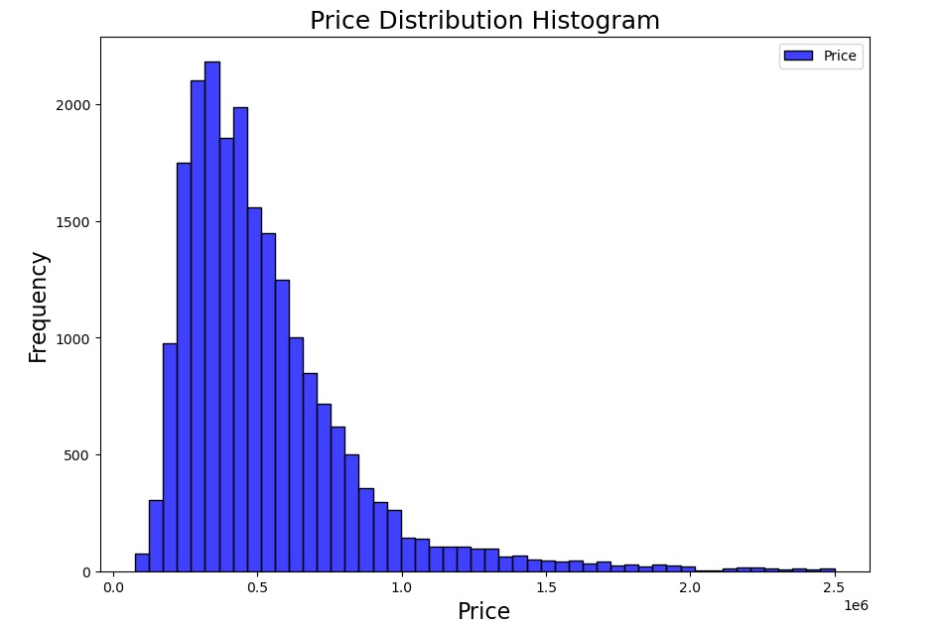
Exploratory Data Analysis
Interpretation:
The histogram suggests that most values fall within a lower price range, while fewer high prices stretch the distribution to the right.
The long tail on the right suggests potential outliers or a few very expensive items in the dataset.

Slide 9
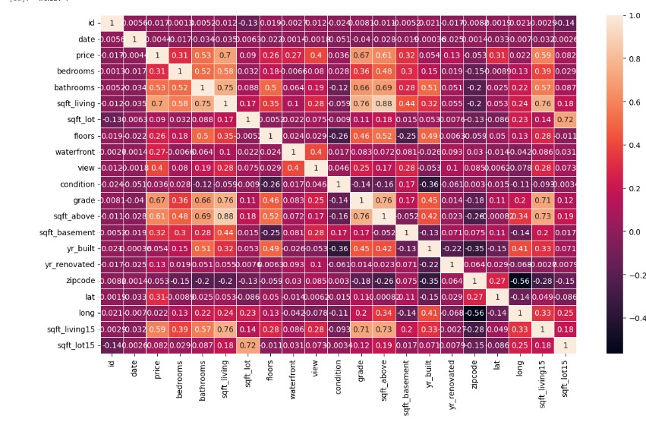
CorrelatIon MatrIx
Square footage of living space (sqft_living): 0.70
Grade of the house (grade): 0.67
Square footage above ground (sqft_above): 0.61
Square footage of living space in 2015 (sqft_living15): 0.59
Number of bathrooms (bathrooms): 0.53
View quality (view): 0.40

Slide 10
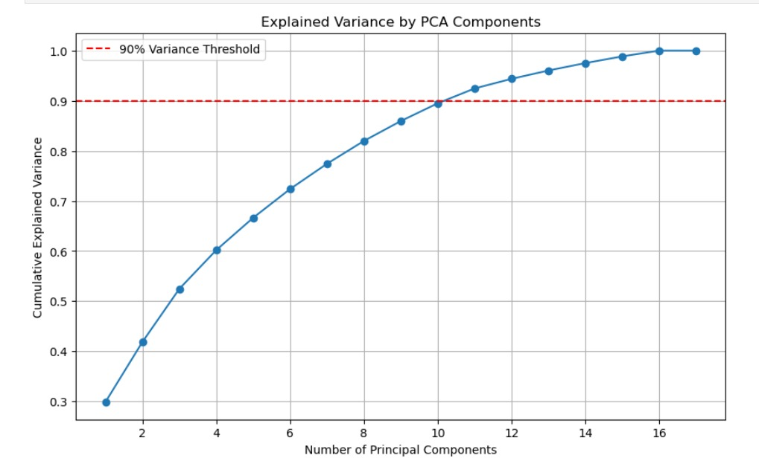
Feature EngIneerIng & SelectIon
PCA for Dimensionality Reduction:
6 components capture ~72% variance.
Diminishing returns after 6 components.
Explained Variance by PCA Components :
Shows cumulative explained variance with increasing principal components.
The red dashed line (90% threshold) indicates the optimal number of components to retain.
Most variance is captured by the first few components, with diminishing gains from additional ones.

Slide 11
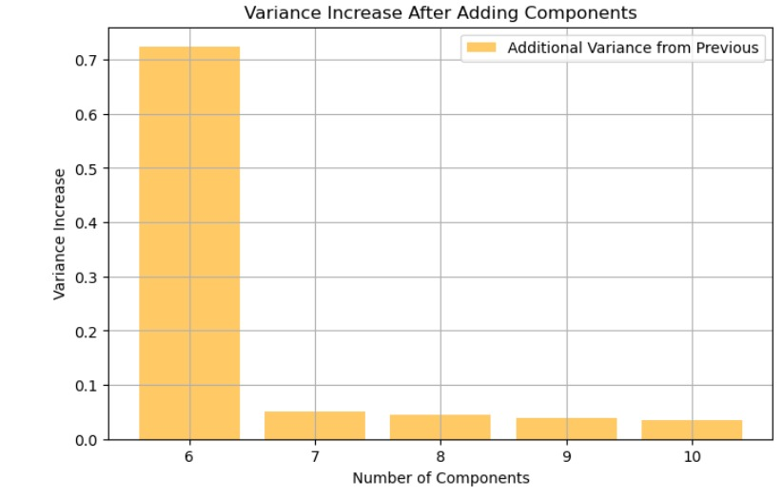
VarIance Increase After AddIng Components :
The 6th component contributes the highest variance, while later components add minimal value.
Suggests that around 6 components are sufficient for effective dimensionality reduction.
Displays the additional variance contributed by each new component after the 6th.

Slide 12
ImplementIng PartIal search algorIthm
BACKWARD ELIMINATON :
Fit the Model: Train a regression model (e.g., Ordinary Least Squares) using all independent variables.
Compute P-values: Assess each feature's statistical significance (p-values).
Feature Elimination: Remove the feature with the highest p-value (above the significance level).
Iterate & Select Features: Repeat the process until all remaining features have p-values below the significance level ensuring the final set includes the most significant predictors.
Top 6 Features After Backward Elimination:
['view', 'grade', 'sqft_above', 'sqft_basement', 'yr_built', 'lat']

Slide 13
KNN REGRESSION(K=5 ,K=10
MODELS USED
LINEAR REGRESSION WITH TOP 6 FEATURES
RANDOM FOREST REGRESSION USING ALL FEATURES
LINEAR REGRESSION WITH PCA
KNN - CLASSIFICATION
RANDOM FOREST REGRESSION TOP 6 FEATURES
RANDOM FOREST USING
PCA FEATURES

Slide 14
LInear RegressIon Performance
Linear Regression Performance measures how accurately a linear model predicts outcomes, typically using error metrics like RMSE. Lower RMSE values indicate better prediction accuracy.
With PCA: RMSE = $188,981.20
With Top Features: RMSE = $193,070.49
Observations: Moderate performance, affected by multicollinearity.

Slide 15
KNN RegressIon Performance
K-Nearest Neighbors Regression predicts values by averaging the target values of the K most similar data points. It makes no assumptions about data relationships, instead relying on the principle that similar inputs should have similar outputs.
KNN-5 (PCA): RMSE = $153,027.17, MAE = $91,540.66
KNN-10 (PCA): RMSE = $155,071.66, MAE = $91,515.45

Slide 16
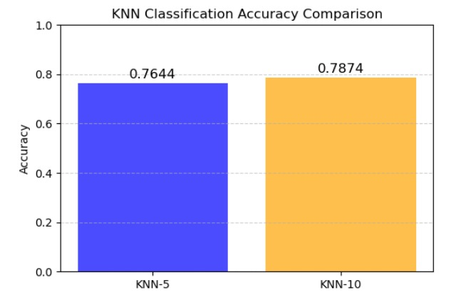
KNN ClassIfIcatIon
KNN Classification assigns data points to categories based on the majority vote from their K closest neighbors in the feature space. It's a simple, non-parametric method that makes predictions based on proximity rather than creating an explicit model.
Converted price to 3 categories (Low, Medium, High).
KNN-5 Accuracy: 76.44%
KNN-10 Accuracy: 78.74%

Slide 17
Random Forest RegressIon
Random Forest Regression combines multiple decision trees, each trained on random data subsets, to predict numerical values. The final prediction is the average of all tree outputs, creating a powerful ensemble model that handles non-linear relationships well and is resistant to overfitting.
All Features: RMSE = $117,528.94
Top Features: RMSE = $153,280.21
PCA Features: RMSE = $150,520.18

Slide 18
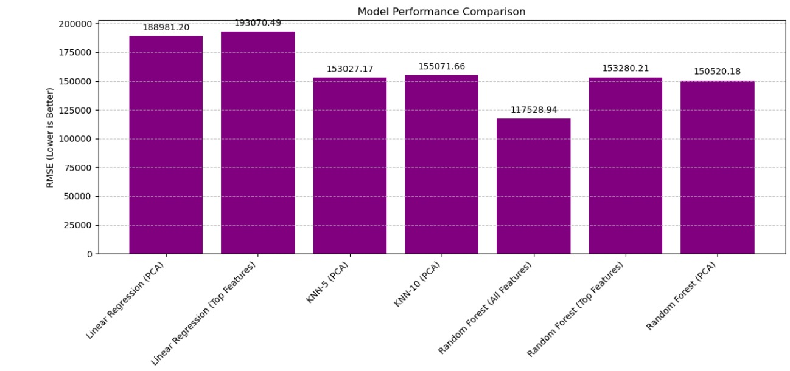
Model Performance Comparison
Random Forest with all features performs best with the lowest error (117,529).
Linear Regression models show the highest error (around 190,000), while KNN and other Random Forest variants have intermediate performance (150,000-155,000).
Lower RMSE values indicate better model performance.

Slide 19
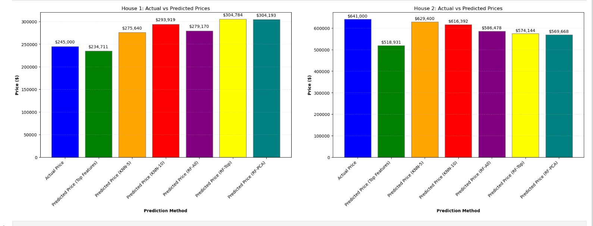
PredIctIng Two House PrIces UsIng All Models and Comparing The Results

Slide 20
LIMITATIONS
KING COUNTY DATA ONLY
MISSING INDICATORS
Static modeling
Lacks geographic diversity
No market-level variables (interest rates, employment)
Doesn't capture market trends and cycles
LIMITED FEATURES
NO DEMOGRAPHIC FEATURES
PROPERTY DETAILS GAP
Missing important property and neighborhood attributes
Population changes and preferences not included
Missing specifics on renovations, quality, unique features

Slide 21
FUTURE ENHANCEMENTS
EXTERNAL FACTORS
Integrate interest rates, economic indicators, policy changes
DEEP LEARNING ENHANCEMENTS
Neural networks, computer vision for images, NLP for descriptions
CLIMATE RISK MODELING
Flood, wildfire, sea level rise, disaster resilience metrics
INTERACTIVE TOOLS
Dynamic dashboards, scenario modeling, map interfaces, comparative visualizations

Slide 22
CONCLUSIONS
01
02
03
ML MODEL’S EFFECTIVENESS
RANDOM FOREST ADVANTAGE
DIMENSIONALITY REDUCTION
ML models accurately predict real estate prices by identifying complex patterns and non-linear relationships traditional methods miss.
Random Forest outperforms other algorithms with full features due to its ensemble approach that captures feature interactions while preventing overfitting.
Feature selection and PCA offer efficient alternatives by identifying key variables or creating composite features while maintaining predictive power

Slide 23
REFERENCES
James, G., Witten, D., Hastie, T., & Tibshirani, R. (2013). An Introduction to Statistical Learning.
Pedregosa, F., et al. (2011). Scikit-learn: Machine Learning in Python.
Course materials & dataset sources.

Slide 24

THANK YOU

